Slide 1
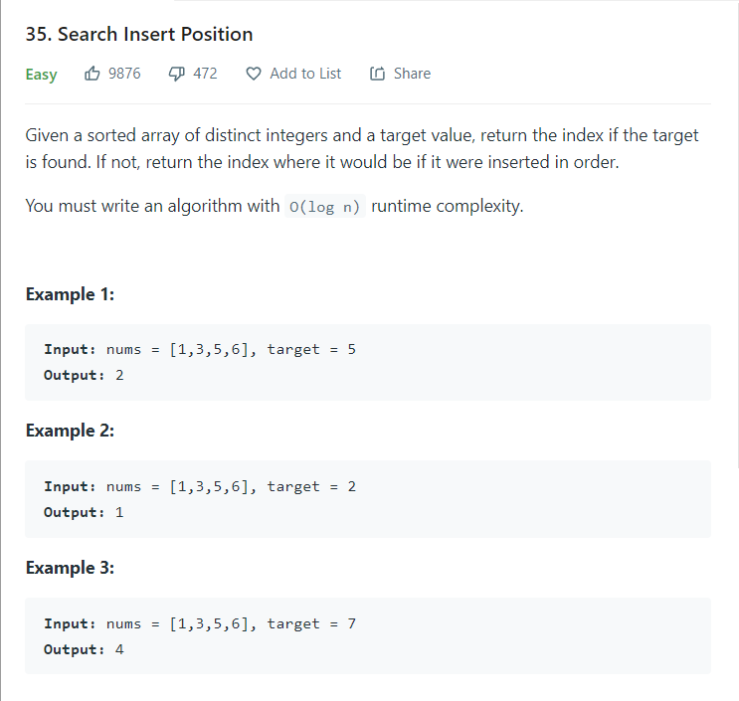
Day 3 of 100dayscodechallenge Platform - LeetCode Problem Statement:

Slide 2
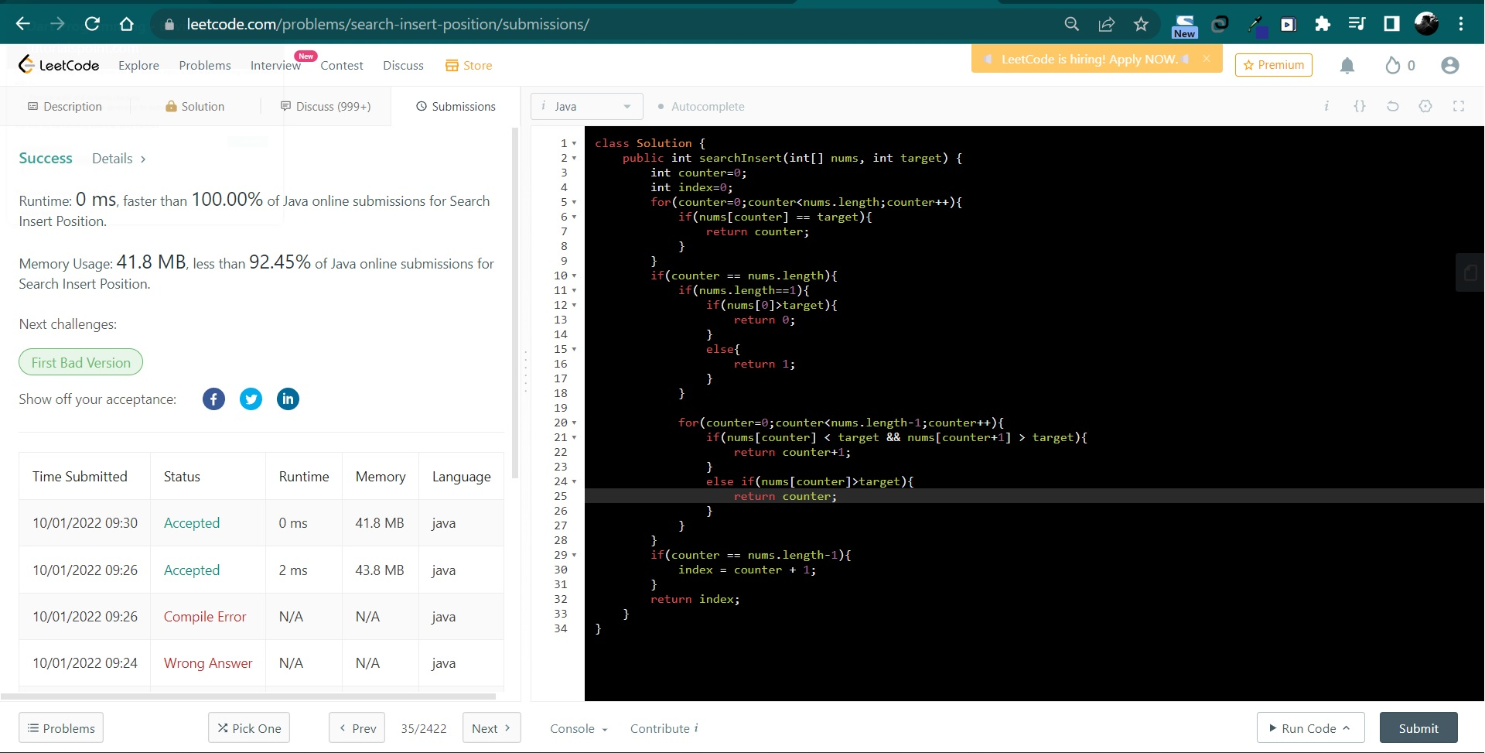
Solutions:

Slide 3
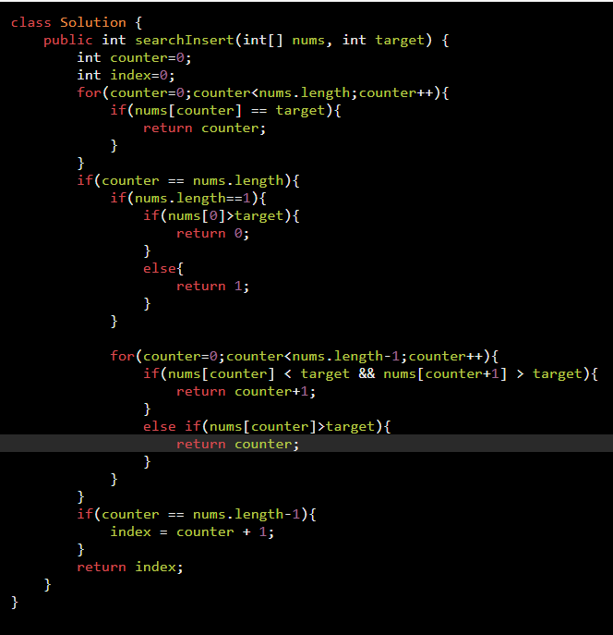
Explanation:
First we are using a loop to traverse through all elements of array. If target element is already present in array then we are returning index of the element.
If element is not present in array then we will check various condition.
First we will check whether only one is present or not. If yes then we will compare array element with target and accordingly we will return index of the target element.
If array more than one element then we will check by comparing target element with is previous value and next value. If condition satisfies then we will return index.
If target element position is first index only then we will return index.
After completing above loop, if index is not found then we will check whether target element will get inserted at last index and we will return index.

